Slide 1
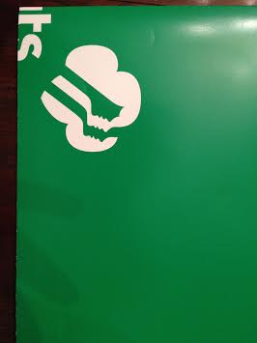
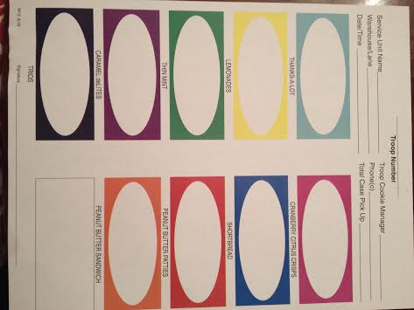
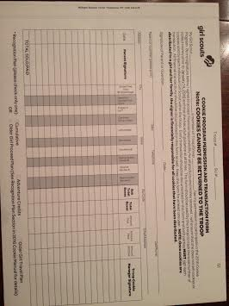
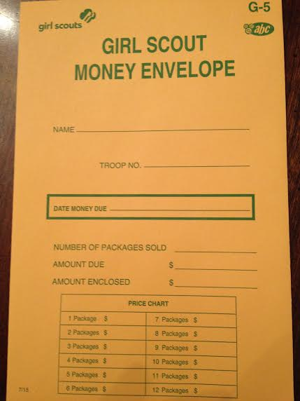
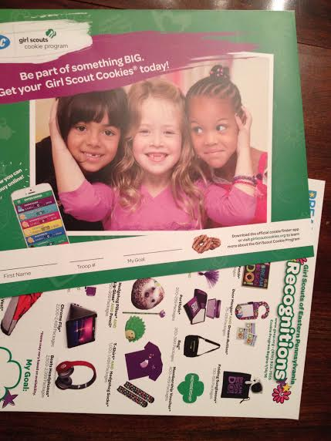
Your Packet:
1 Cookie Pick-up Sheet
1 Cookie Manual
2 Receipt Books
1 Booth Poster
2-3 T8 Forms
T-8
Each girl gets one of the following:
Cookie order sheet w/recognitions insert
Permission and Transaction form
Money Envelope

Slide 5
A Powerful Brand
Dollars
$250,000,000
$200,000,000
$150,000,000
$100,000,000
$50,000,000
$0
Oreo
GS PB
Nilla Wafer
Chewy
GS PB
GS
Chips
GS Thin
Oreo
Oreo
(19.1
oz
)
Sandwich
Chips
Patties
Caramel
Ahoy!
Mints
Double Stuf
(14.3
oz
)
Ahoy!
deLites

Slide 7
Program Dates?
January 19, 2017-March 12, 2017

Slide 8
Important Dates
November 21: Booth Lottery Closes December 5: Troop Initial Order Due December 7: SU Initial Order Due January 7-15: Mega Drops/Home Deliveries January 19: Cookie Program Starts February 24-26: National Cookie Weekend February 26: Cookie Crunch March 12: Cookie Program Ends March 18: OCFH Drop- Berks, DelCo, Philadelphia March 25: OCFH Drop- SR, VF, LV 2nd Week of June (TBA): 500 Club Picnic TBA, June: Mystery Tour

Slide 9
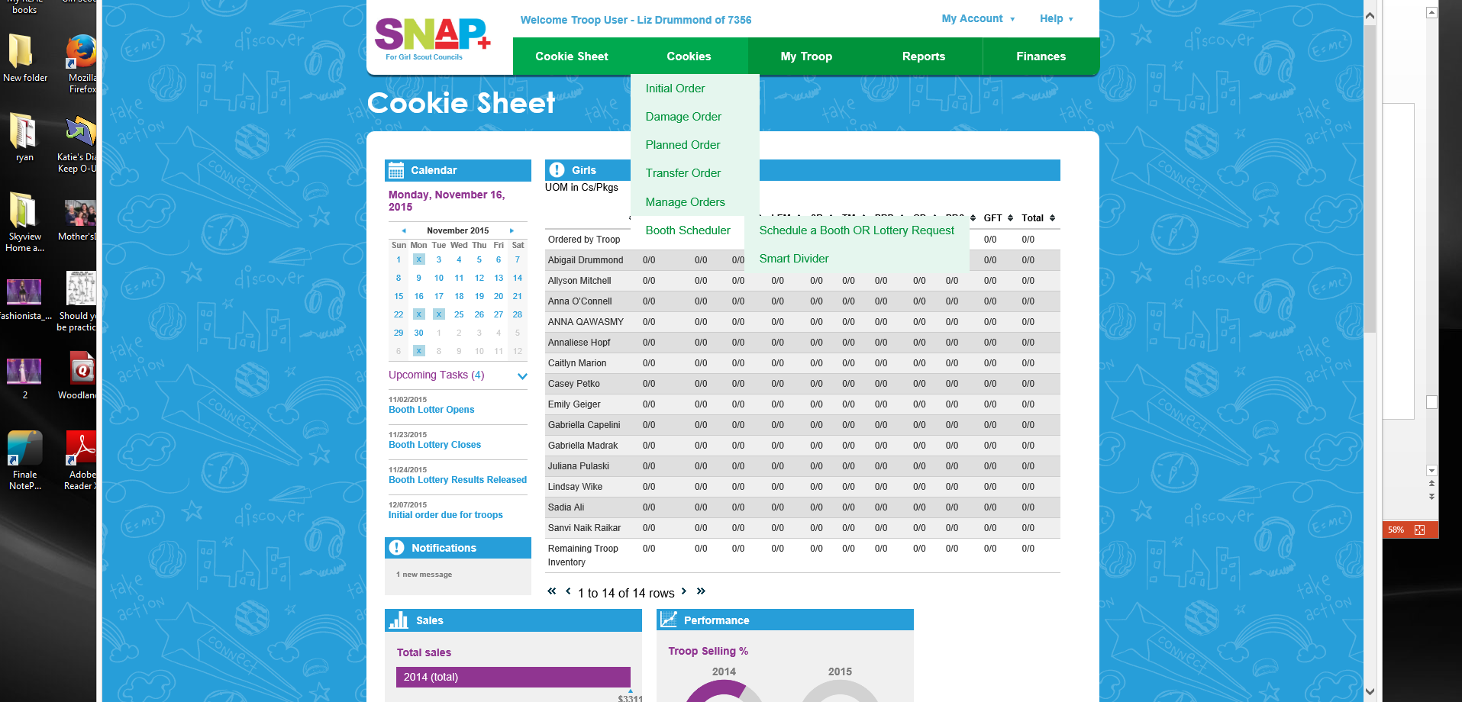

Slide 11
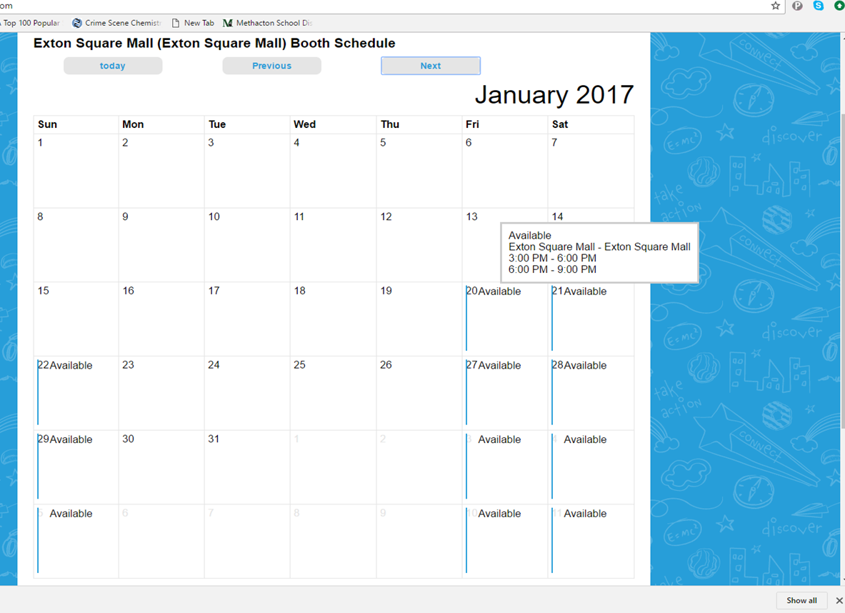

Slide 12
NEW SOCIAL MEDIA!
Sign up for Remind!!
Facebook Group Page for Cookie Exchanges

Slide 13
Service Unit Proceeds Calculation
Girls Selling divided by Girls Registered: 90%, 93%, 98%
Increase Packages Sold Over Previous Year: 3%, 5%, 10% (2015: 39,741)
Initial Cookie Order Increase: 3%, 5%, 10% (2015: 17,940)
Zero parent and troop uncollected monies by March 31st (Yes/No)
All troops in the Service Unit complete each ACH Sweep on assigned date and the calculated amount
2014: SU earned about $585.00 from cookie sales
2015: SU only earned 238.45
2016: SU earnings back up to $499.

Slide 14
Initial and Planned Orders
•
Initial Order: First order a troop places in Snap+
•
Due in Snap+ by December 5, 2016
•
Planned Order: placed in Snap+ by noon the day before
Must pick up
•
all
cases
Schedule will be on
www.gsep.or
•
g
soon!

Slide 17
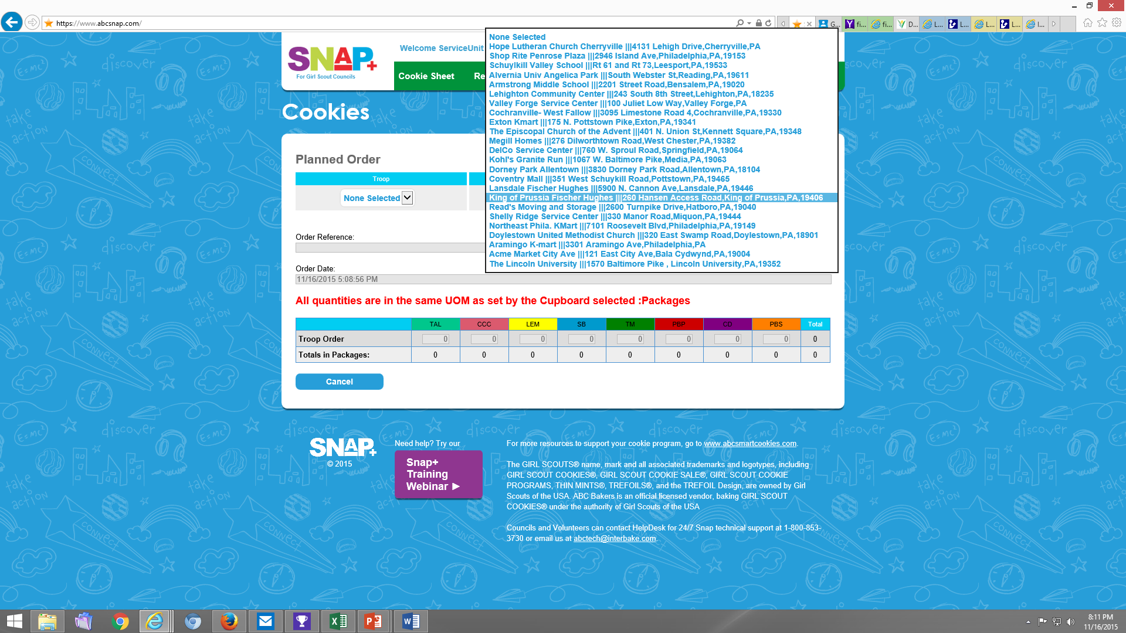

Slide 18
Average Sales Mix by Cookie
5
%
CD
10
%
19
%
PBP
7
%
SB
TM
16
%
PBS
10
%
TAL
LEM
8
%
25
%
CCC

Slide 19
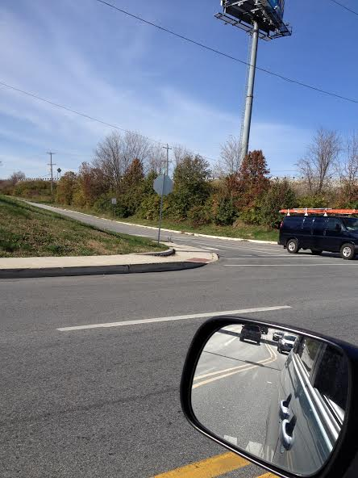
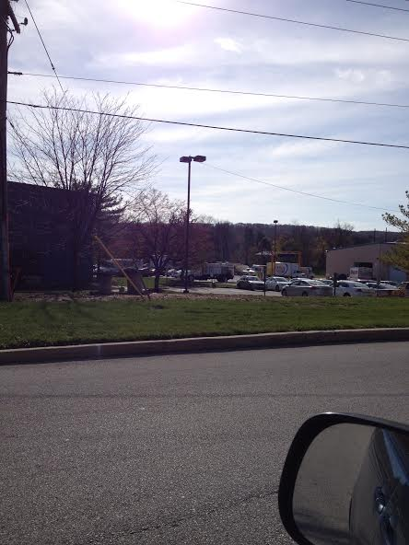
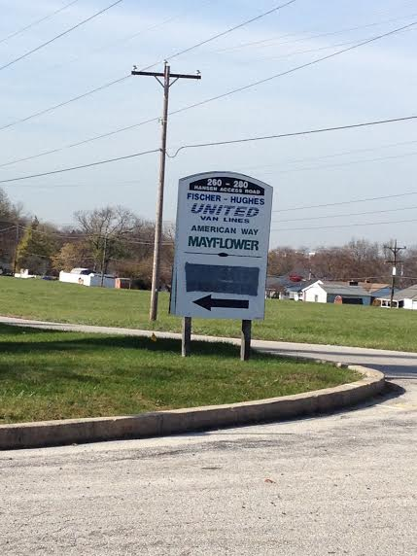
Where Do I Pick Up Cookies?!?!
King of Prussia Fischer Hughes: 260 Hansen Access Rd., King of Prussia
Hansen Access Rd
Warehouse with Doritos/Chips Trucks
Look for United/Mayflower Sign

Slide 20
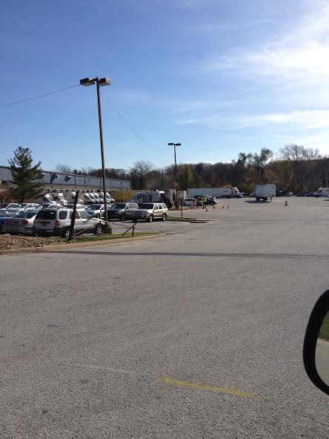
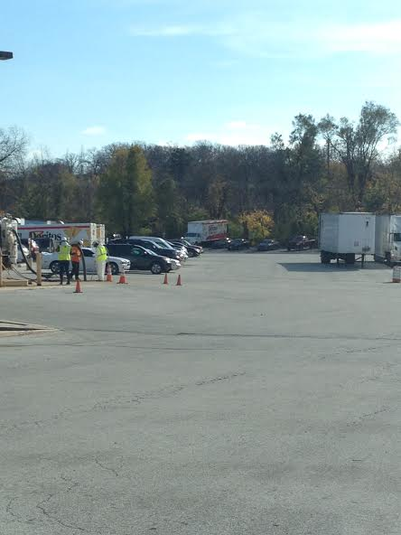
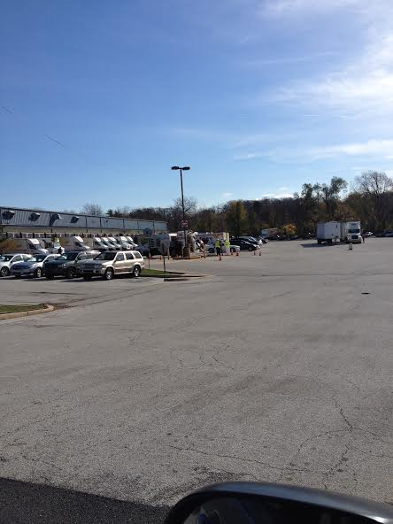
Back Here

Slide 21
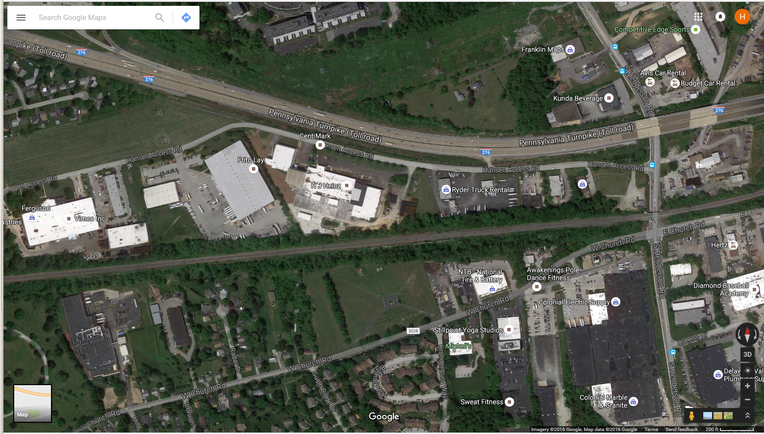

Slide 22
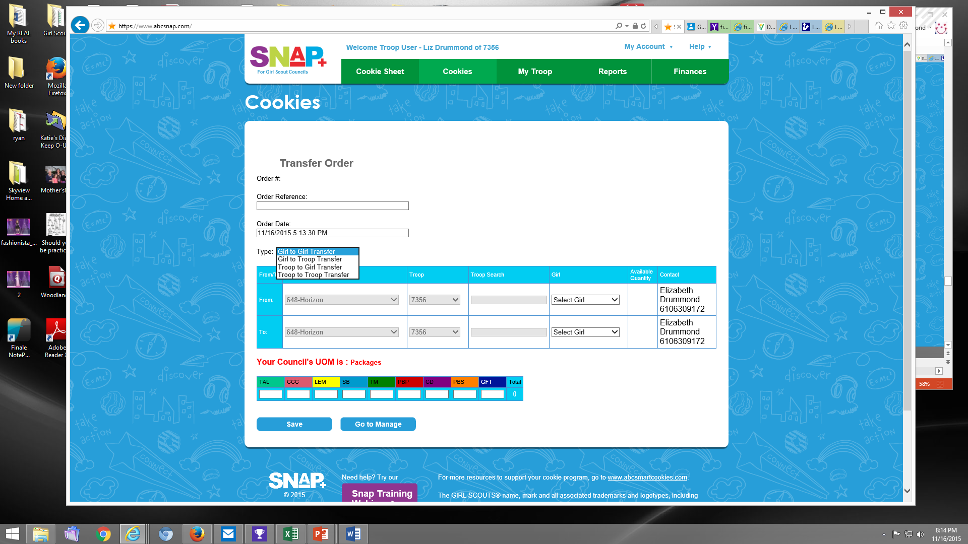

Slide 23
Resources
www.abcsnap.co
•
m
www.abcsmartcookies.co
•
m
www.gsep.or
•
g
•
2017
Cookie Manual
•
GSEP YouTube Channel
•
Cookie Toolkit

Slide 24
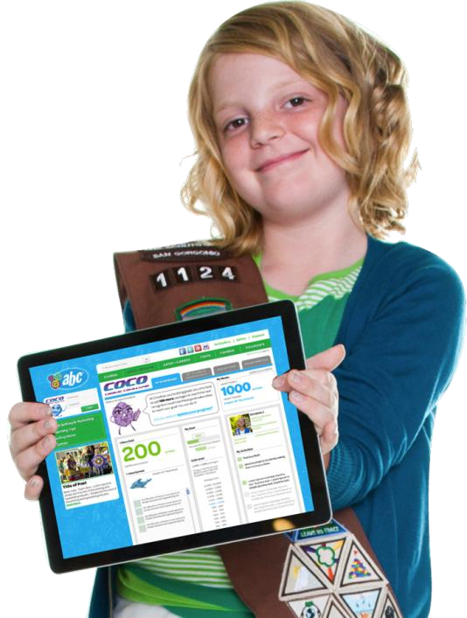
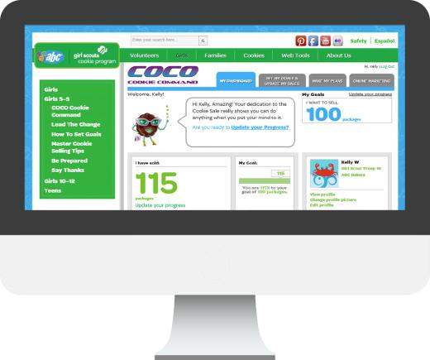
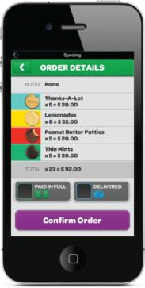
COCO

Slide 25
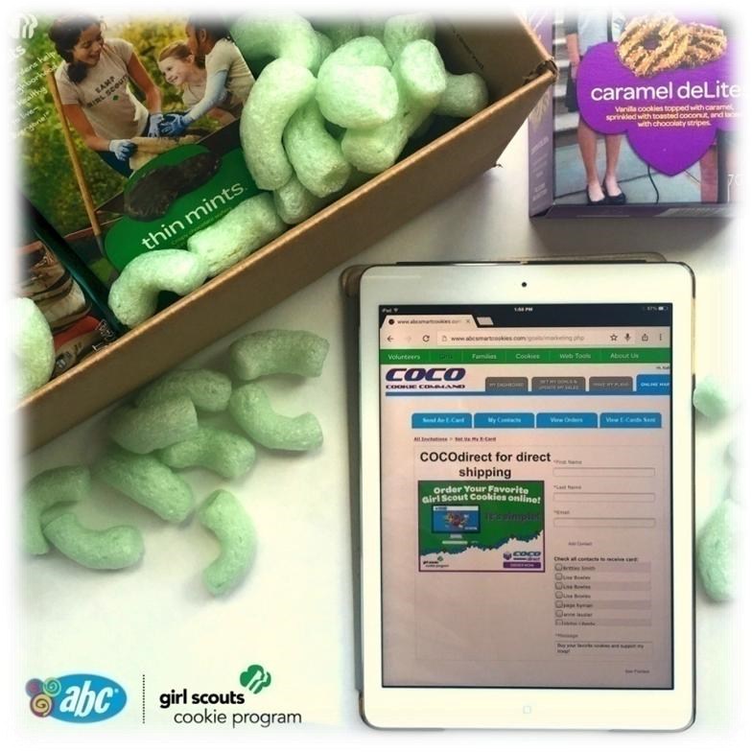
Direct Shipment of Girl Scout Cookies to Customers
•
COCOdirect
is a mobile
and online platform for
online ordering and bulk
direct
delivery of Girl
Scout Cookies
Note: Direct delivery through
COCOdirect
is ONLY available to
consumers that purchase a minimum
order of half dozen single variety or an
eight
-
pack sampler.

Slide 26
Closing Procedures
•
Troops enter their Recognition Orders in Snap+
SUCM needs all
•
signed
Troop Balance
Summary Reports and any T
-
5
Parent Debt
Forms by April 5th
•
Drop them off to me on my porch, 556 Long Meadow Rd., Eagleville

Slide 27
ACH
•
ACH is the automatic clearing house that allows GSEP to sweep funds due
for Cookies
•
Contact
ach@gsep.org
for questions
Date
Sweep Details
February
2
,
2017
15
% of troop inventory
March 2, 2017
35
% of troop
inventory
March
23
,
2017
100
% less troop proceeds

Slide 28
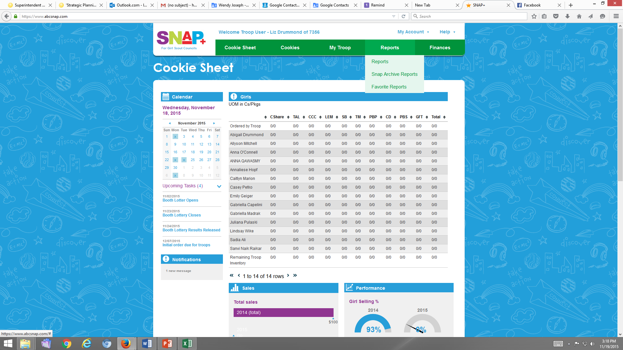

Slide 29
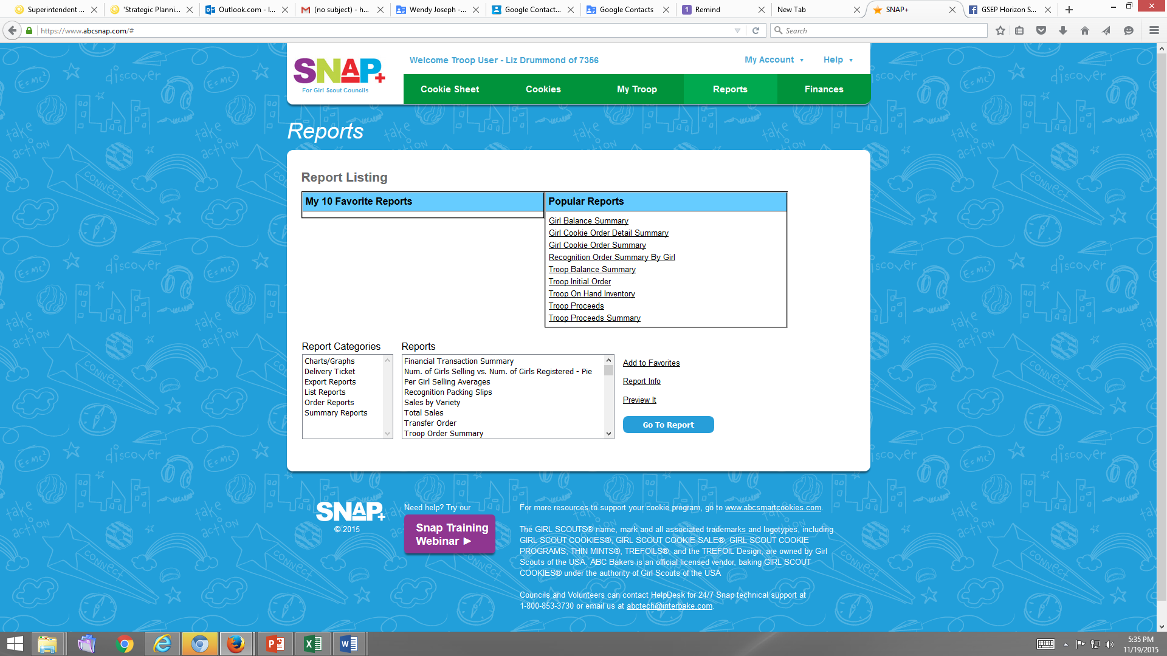

Slide 30
Questions?

